Slide 1
SPORTS FACILITIES
S. No | Description | Details | Quantity
1. | Details/Area of the Play ground | Total Area: 3,13,934 Sq. Ft | 02
 |  | Total Area: 1,30,680 Sq.Ft
2. | Details of indoor games available | Chess Boards | 05
 |  | Caroms Boards | 04
 |  | Badminton | 06
3. | Details of outdoor games available | Kabaddi Court | 01
 |  | Volleyball Court | 01
 |  | Cricket Ground | 01
 |  | Kho-Kho Court | 01
 |  | Basket Ball Court | 01
 |  | Ball Badminton Rockets | 06
 |  | Hockey | 12
 |  | Tennikoit | 04

Slide 2
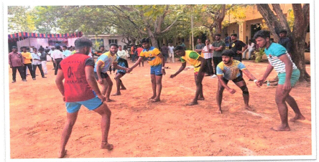
Playing Kabaddi

Slide 3
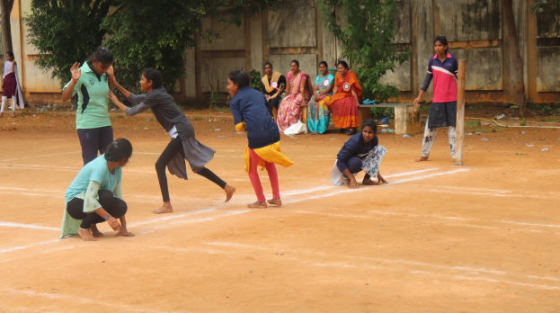
Playing Kho - Kho

Slide 4
S. No | Description | Details | Quantity
4. | Details of Athletics | Javelin throw | 02
 |  | Discus throw | 02
 |  | shotput | 03
 |  | 200 M Track | 01
5. | Details of fitness equipment | Fitness Machine | 03
 |  | Treadmills | 5
 |  | Fitness Cycles | 4
 |  | Domestic Plain Bench | 3
 |  | Domestic Dumbbells Rack | 2
 |  | Domestic Multi Bench Press | 3
 |  | Plain Rods 50MM 3feet | 5
 |  | Plain Rods 50MM 5feet | 3
 |  | Plain Rods 50MM 7 feet | 3
 |  | Zig-Zag Road | 5
 |  | Dumbbell Rubber Set | 2
 |  | Plates | 20

Slide 5
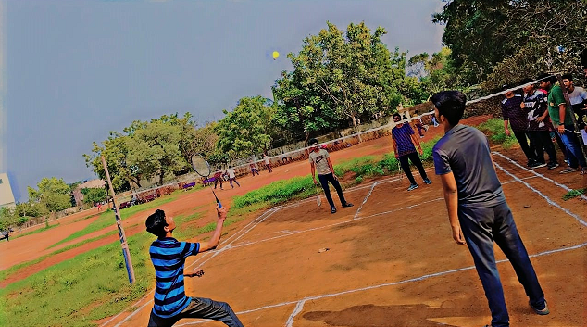
Playing Shuttle

Slide 6
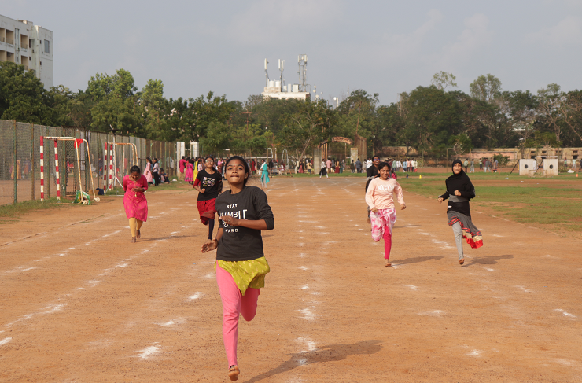
Running race

